Slide 1
topicFour
Using Images

Slide 2
Learning Objectives
At the end of this chapter the students should be able to:
Save and define graphics file name into file directory.
Specify graphics file alignment in web page.
Inserting appropriate image size and resolution
Manipulating graphic to enhance the impact of the web page to visitors

Slide 3
Introduction
Computers store images in several different ways.
Some storage methods focus on compressing the size of the image as much as possible.
A major problem with using images on websites is that images take much longer to load than text.
To reduce download times as much as possible two of the best image compressing formats used on the web are.

Slide 4
Image Formats and Compressions
GIF | JPG
256 colors | Unlimited colors
Can handle transparent area | Can’t handle transparent area
Not good at compressing photograph | Excellent for compressing photograph and complex images
Suitable for banner, button and clipart | Suitable for photograph

Slide 5
Image Formats and Compressions
Image compression is minimizing the size in bytes of a graphics file without degrading the quality of the image to an unacceptable level.
The reduction in file size allows more images to be stored in a given amount of disk or memory space.
It also reduces the time required for images to be sent over the Internet or downloaded from Web pages.
There are several different ways in which image files can be compressed

Slide 6
Image Formats and Compressions
For Internet use, the two most common compressed graphic image formats are the JPEG format and the GIF format.
The JPEG method is more often used for photographs, while the GIF method is commonly used for line art and other images in which geometric shapes are relatively simple.

Slide 7
Image Formats and Compressions
GIF is a graphics format commonly used for Web page line art images.
Its supports 256 colors though can use a smaller color palette as needed.
Gif can be transparent, interlaced and uses lossless file compression.
Several GIF images can be combined to form animated GIFs

Slide 8
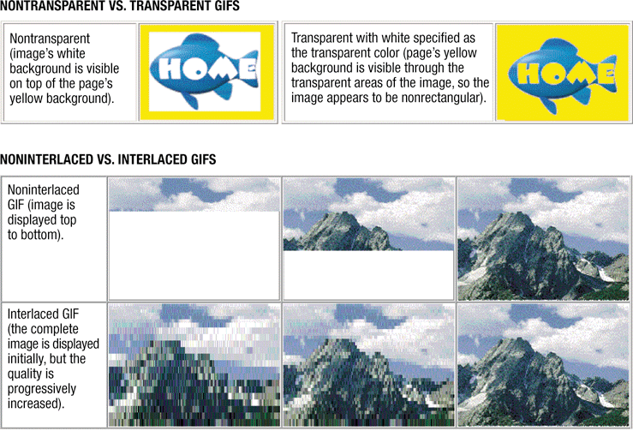

Slide 9
Image Formats and Compressions
PNG format meanwhile designed specifically for use with Web page images.
Its support lossless compression, and with more efficiency than GIF, can use color palette or true color and cannot be animated.
JPEG format supports true color and is commonly used for photographs inserted in Web pages.
It can be progressive, uses lossy file compression and the amount of compression is specified when the file is saved

Slide 10
Lossy and Lossless Compression
Lossless compression lets you recreate the original file exactly.
All lossless compression is based on the idea of breaking a file into a "smaller" form for transmission or storage and then putting it back together on the other end so it can be used again

Slide 11
Lossy and Lossless Compression
Lossy compression works very differently.
These programs simply eliminate "unnecessary" bits of information, tailoring the file so that it is smaller.
This type of compression is used a lot for reducing the file size of bitmap pictures, which tend to be fairly bulky

Slide 12
Lossy and Lossless Compression
To see how this works, let's consider how your computer might compress a scanned photograph.
A lossless compression program can't do much with this type of file.
While large parts of the picture may look the same, such as the whole sky is blue.
Most of the individual pixels are a little bit different.
To make this picture smaller without compromising the resolution, you have to change the color value for certain pixels.
If the picture had a lot of blue sky, the program would pick one color of blue that could be used for every pixel.
Then, the program rewrites the file so that the value for every sky pixel refers back to this information.
If the compression scheme works well, you won't notice the change, but the file size will be significantly reduced.

Slide 13
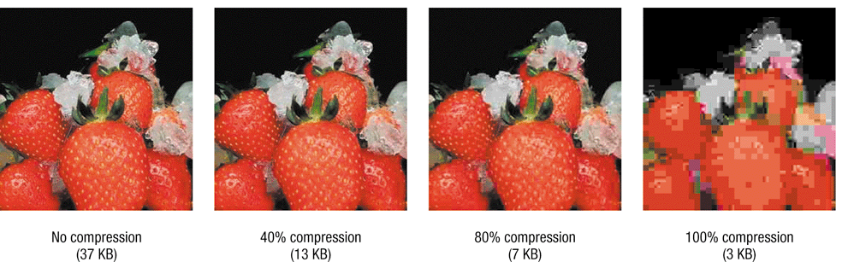

Slide 14
Inserting Images on Page
The tag for inserting images into a page is <img>.
Among the attributes that can be used are src, width, height, and alt.
Unlike other tags, the image tag doesn’t have a closing tag

Slide 15
Syntax | HTML | Text
<img src=" "> | <img src="house.jpg"> <img src="http://www.mac.com/house.jpg">

Slide 16
Inserting Images on Page
SRC tells where to get the picture that should be put on the page. SRC is the one required attribute for <img>.
SRC is a hypertext reference, like the hyperlink attribute.
The reference can be relative or it can be a "fully qualified" reference.
The most common use for fully qualified references is for the images you see on some web pages

Slide 17
Specifying Images for Speedier Viewing
You can change the size of an image using the width and height attributes.
In general, it is not advisable to reduce image size using these settings, since the image will be transferred over the internet in its original size no matter what reduction is set for it.
This will slow the loading of your webpage.

Slide 18
Specifying Images for Speedier Viewing
This means, that if you have an image that is bigger in size than you want it to be on your page, you should reduce the size in a graphics program, rather than reducing the size on the webpage using the width and height attributes
On the contrary, sometimes, it can be wise to enlarge images using this technique.

Slide 19
Specifying Images for Speedier Viewing
The width and height tell the browser the dimensions of the image.
The browser can use this information to reserve space for the image as it constructs the page, even though the image has not downloaded yet.
The width and height do not have to be the same dimensions as the actual picture

Slide 20
Specifying Images for Speedier Viewing
If you set different dimensions, the browser will attempt to shrink/stretch the picture to accommodate the dimensions.
Furthermore, you can use percentages instead of pixel widths.
Percentages are of the available width or height that the image could fill, usually the width or height of the current window.

Slide 21
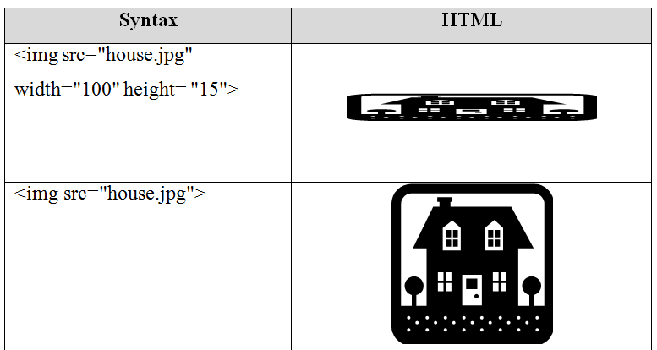

Slide 22
Adding Border Around Images
You can add a border to the image using the border setting shown in the example below.
Netscape browsers will only show the border if the image is a link.
Adding a border to your image might help the visitor recognize that the image is a link

Slide 23
Adding Border Around Images
However, the net is filled with images that work as links and have no borders indicating it - so the average visitor is used to letting the mouse run over images to see if they are links

Slide 24
Adding Border Around Images
Still - if you have an image that is often mistaken you might consider adding a border to it - although you should probably consider changing the image entirely - since if it does not indicate by itself that it is a link then it is not serving its purpose.

Slide 25
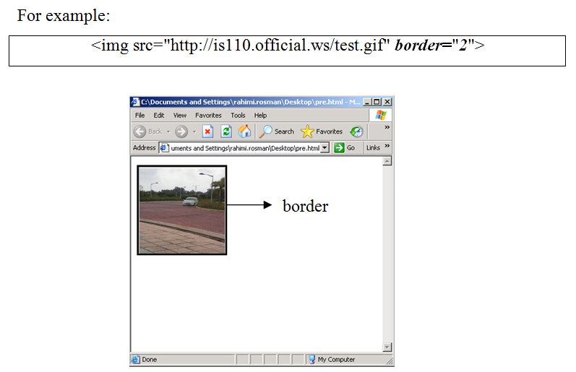

Slide 26
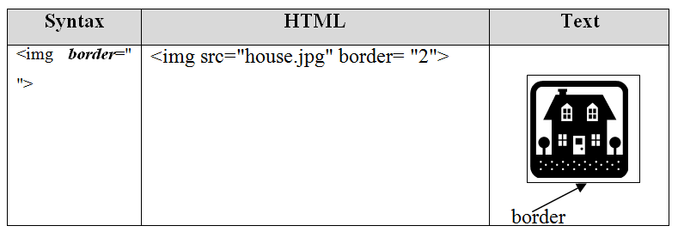

Slide 27
Offering Alternative Text
You should always add alternative texts to your images, so the users can get an idea of what the image is about before it is loaded.
This becomes particularly important if the image is a link.
Few things are as annoying as knowing that you want to leave the current page - and at the same time being forced to wait for an image to load before being able to do so.
It is extremely tempting to use the browser's straightforward options to leave the entire site instead.

Slide 28
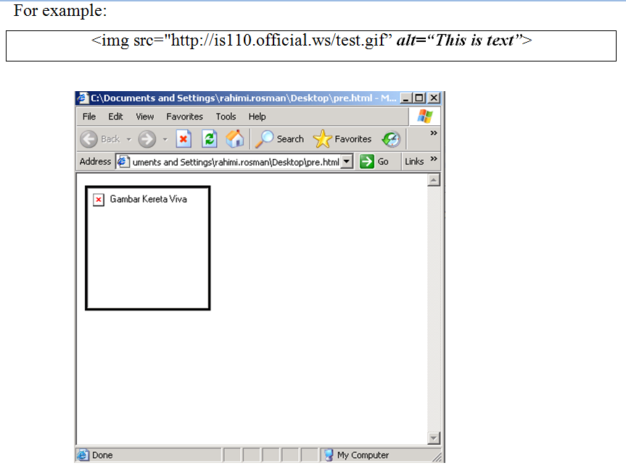

Slide 29
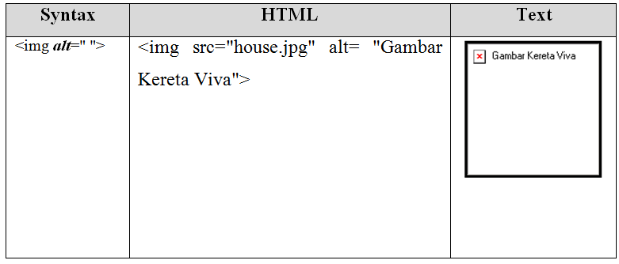

Slide 30
Adding Spaces Around An Image
You can easily add space over and under your images with the vspace attribute.
In a similar way you can add space to the left and right of the image using the hspace attribute.

Slide 31
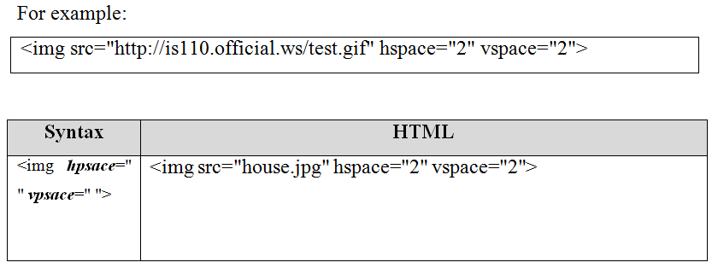

Slide 32
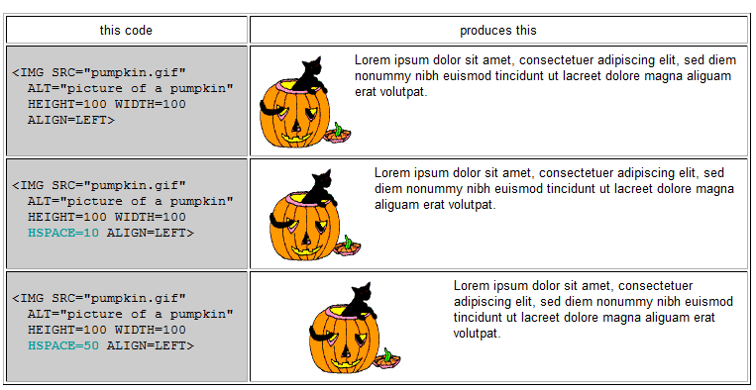
The following examples show hspace when it is not used, when it is set to 10, and when it is set to 50.

Slide 33
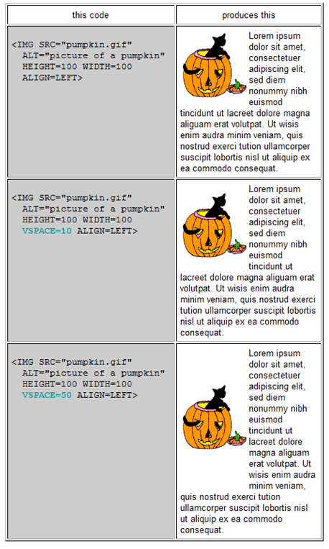
The following examples show vspace when it is not used, when it is set to 10, and when it is set to 50.

Slide 34
Aligning Images
ALIGN sets the alignment of the image relative to the text around it.
The values for ALIGN can be divided into two groups: LEFT and RIGHT, which put the image on the left or right side of the page; and all the other values, which concern the vertical placement of an inline image.
You can align images according to the text around it, using the following alignments:

Slide 35
Attribute | Function
Default | Aligns the image using the default settings of the Web browser. Same as baseline.
Left | Aligns the image in the left margin and wraps the text that follows the image.
Right | Aligns the image in the right margin and wraps the text that precedes the image.
Top | Aligns the top of the image with the surrounding text.
Texttop | Aligns the top of the image with the top of the tallest text in the line.
Middle | Aligns the middle of the image with the surrounding text.
Absmiddle | Aligns the image with the middle of the current line.
Baseline | Aligns the image with the baseline of the current line.
Bottom | Aligns the bottom of the image with the surrounding text.
Absbottom | Aligns the image with the bottom of the current line.
Center | Aligns the center of the image with the surrounding text.

Slide 36
File Naming
The most common filename extension for files containing HTML is .html.
A common abbreviation of this is .htm; it originates from older operating systems and file systems, such as the DOS versions from the 80's and early 90's and FAT, which limit file extensions to three letters.
Both forms are widely supported by browsers.

Slide 37
File Naming
A good webmaster should never leave a space between image file (or any file) because certain web server don’t support this kind of file structure.
For consistency, always put your images in “IMAGES” folder.
Putting the graphic in the same folder with the html file will just mess up the folder

Slide 38
Linking Thumbnails to Images
The first step in creating a thumbnail image link is to create the thumbnail image.
You can create the appearance of a thumbnail image by just adjusting the width and height parameters on the image link but that totally defeats the purpose in having the thumbnail image because the entire large image file needs to be downloaded in order to display the thumbnail

Slide 39
Linking Thumbnails to Images
You need a separate smaller image to use for the thumbnail and you can create this either using a graphics program on your own computer or alternatively, using an online thumbnail creation facility.
The primary purpose in creating the thumbnail image is to split the download of the image out from the page and give the visitor the choice of whether they want to download it or not.

Slide 40
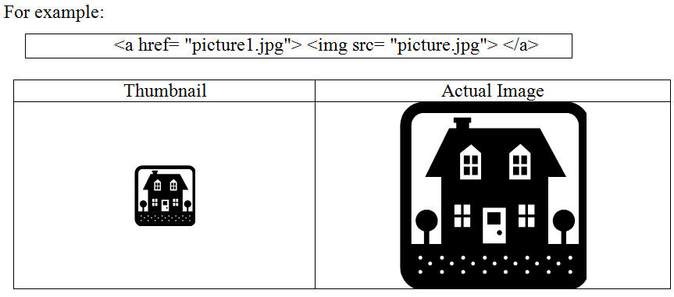

Slide 41
Adding Horizontal Rules
One of the most important aspects of web communication is making content clear and intuitively organized for users.
A web page that consists of huge blocks of text without breaks and formatting will likely lose readers far before achieving the goals of the site.
There are many ways to achieve a well-structured site, including the use of horizontal rules.
A horizontal rule is a line stretching horizontally across a web page that shows a reader the end or beginning of a section.

Slide 42
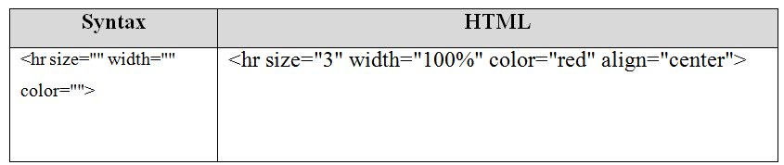

Slide 43
Making Images Float
In HTML, the align attribute is used to align images to the left or right side of a page, allowing text to wrap around the image.
However, the align attribute has been deprecated and can no longer be used if you want an XHTML-compliant site.

Slide 44
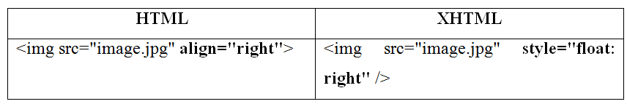
Making Images Float
Expression Web, which creates XHTML-compliant code, will allow you to align images to the left or right of a page, but will use an inline style to create code that "floats" the image to the left or right instead.
You can see the difference in the HTML code below:

Slide 45
Stopping Elements from Wrapping
A floated image affects all the elements that follow it, unless you insert a special line break.
The clear attribute added to the regular br tag indicates that the text should not begin until the specified margin is clear (that is, at the end of the image or images).

Slide 46
